Slide 1
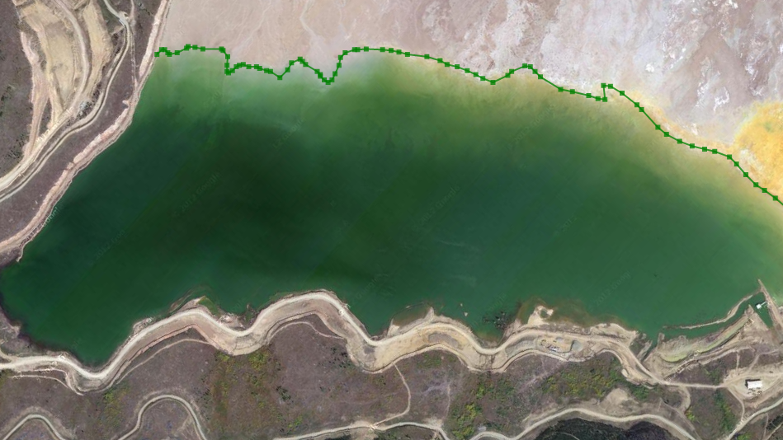
Coastline Detection in Satellite Imagery
CSE 472 Machine Learning Sessional Project
Group 3 (A1)
1905016 – Zulkar Naim
1905024 – Rakib Ahsan

Slide 2
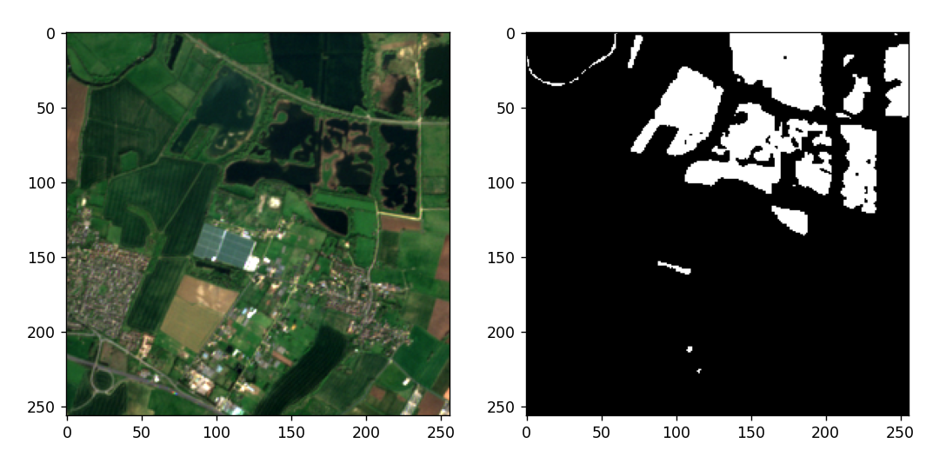
Problem Definition
Coastline detection in satellite imagery: A deep learning approach on new benchmark data
Automatic coastline extraction through enhanced sea-land segmentation by modifying Standard U-Net
Semantic segmentation of coastal aerial/satellite images using deep learning techniques: An application to coastline detection
Sentinel – 2 (12 bands)

Slide 3
Dataset
Link: https://openmldata.ukho.gov.uk/
Input: 256 x 256 x 12 Sentinel-2 images
Output: 256 x 256 x 1 binary mask (1 for water body, 0 for land)
Dataset size:
26,468 training samples and 100 independent test samples
Images containing both classes are 9013
approx. 18 GB (zip)

Slide 4
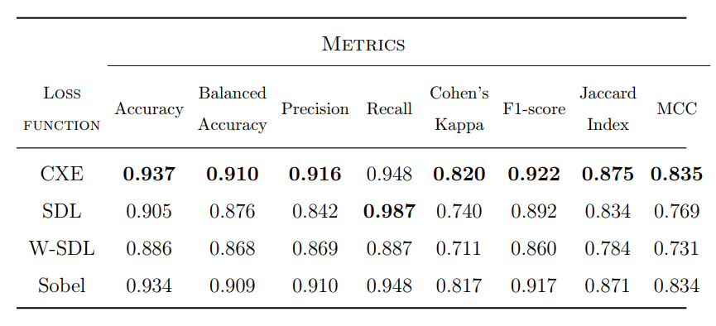
Paper Performance Metrics
U-Net Architecture

Slide 5
Proposed Solutions
U-Net
U-Net with Channel Spatial Attention
MultiResUNet
MultiResUNet with Channel Spatial Attention
SwinUNet
TransUNet

Slide 6
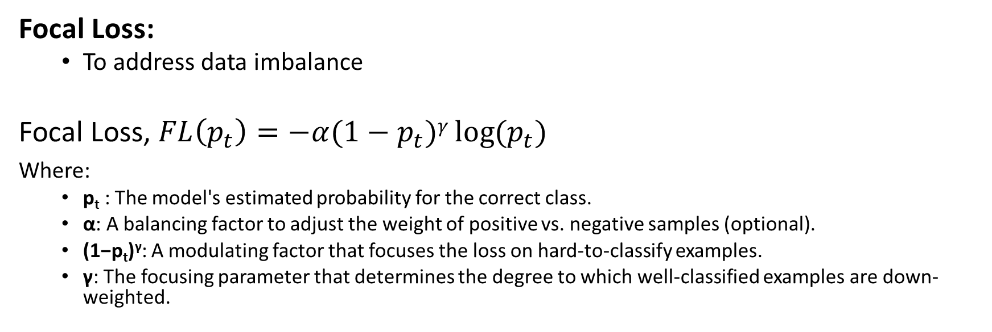
Loss Function
Focal Loss:
To address data imbalance
Focal Loss, $FL\left(p_{t}\right)=−α(1−p_{t}​)γ⁡\log{(p_{t}​) }$
Where:
p_{t}​ ​: The model's estimated probability for the correct class.
α: A balancing factor to adjust the weight of positive vs. negative samples (optional).
(1−p_{t}​)^{γ}: A modulating factor that focuses the loss on hard-to-classify examples.
γ: The focusing parameter that determines the degree to which well-classified examples are down-weighted.

Slide 7
Performance Metrics for Our Approaches
Metric | U-Net | U-Net + Attention | MultiResUNet | MultiResUNet + Attention | SwinUNet | TransUNet
accuracy | 0.893694 | 0.913052 | 0.91562 | 0.902392 | 0.896011 | 0.940173
bal_accuracy | 0.901379 | 0.914918 | 0.912634 | 0.906614 | 0.89906 | 0.939501
precision | 0.961387 | 0.943596 | 0.920495 | 0.948143 | 0.936364 | 0.951013
recall | 0.848395 | 0.902053 | 0.933222 | 0.877505 | 0.87804 | 0.944135
f1_score | 0.901364 | 0.922357 | 0.926815 | 0.911457 | 0.906264 | 0.947562
jaccard_index | 0.820439 | 0.855902 | 0.863611 | 0.837319 | 0.828596 | 0.900349
cohen_kappa | 0.787065 | 0.823685 | 0.827209 | 0.803077 | 0.789775 | 0.877924
mcc | 0.794313 | 0.824763 | 0.827318 | 0.806067 | 0.791835 | 0.877956
loss | 2974.232 | 3070.941 | 2358.857 | 2190.187 | 2433.337 | 1883.408

Slide 8
TransUNet Architecture

